Slide 1

Remote Mapping with the HOT Tasking Manager

Slide 2
Overview
How HOT uses the Tasking Manager
Logging in (Your user page)
Finding a project
Selecting, splitting and releasing a square to map
Marking your square as complete
Live Help - IRC, Internet Relay Chat, and other Tips

Slide 3
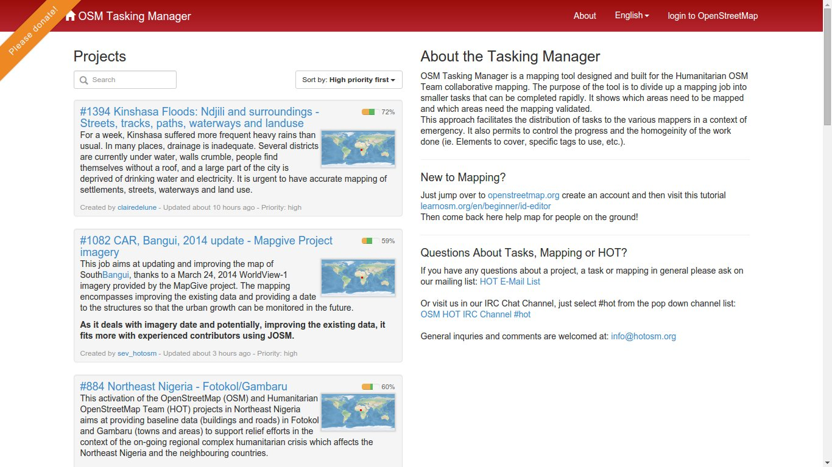
How HOT Uses the Tasking Manager

Slide 4
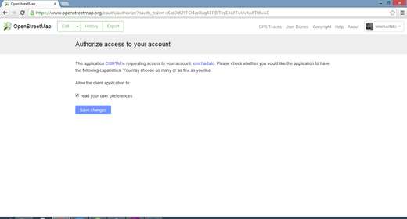
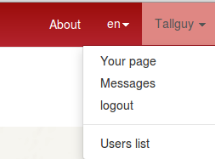
Logging in - User Page

Slide 5
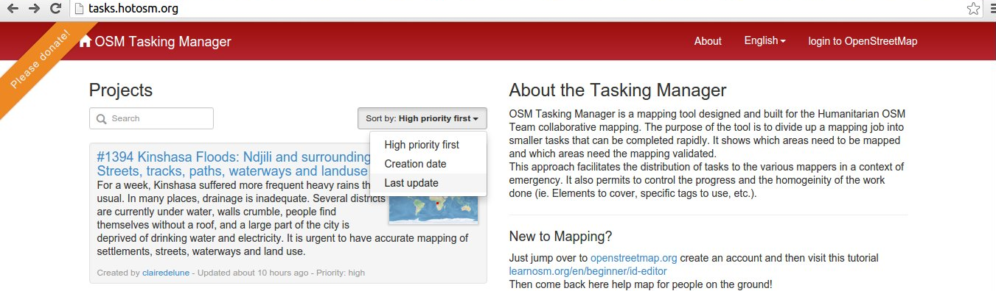
Finding a project
Search box
High priority
Creation date
Project name and number
Last update

Slide 6
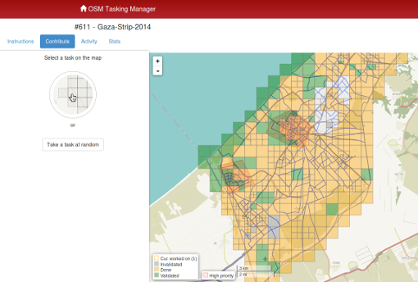
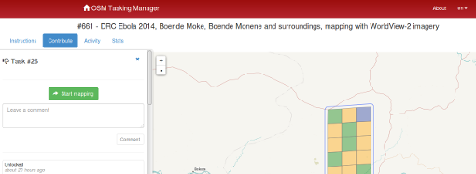
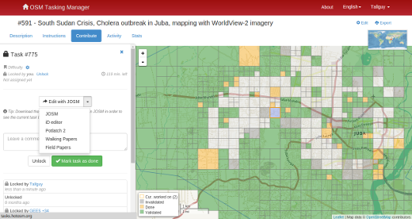
Mapping a square

Slide 7
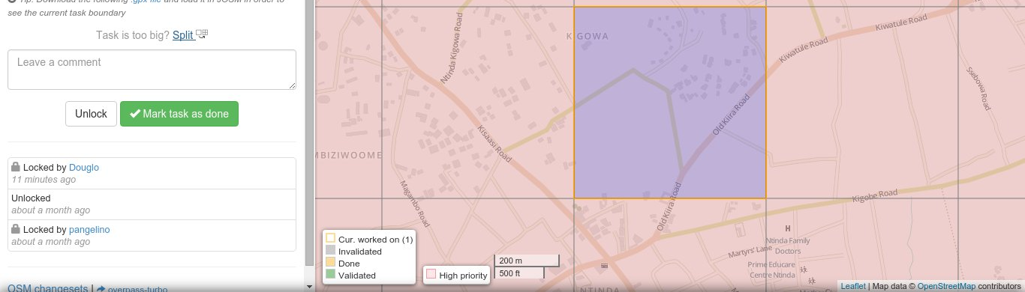
Mark as Complete
If you are sure all contents mapped as instructed..…
Finish Editing with your preferred Editor.
Save Your Edits.
Return to the Tasking Manager.
Add comments to the box detailing what you edited.
Click on the “Mark Task as Done” button.
Your work is ready for review.

Slide 8
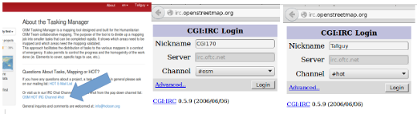
Help and Other Tips

